Slide 2
“The gospel is the power of God to salvation for everyone who believes” (Romans 1:16)

Slide 3
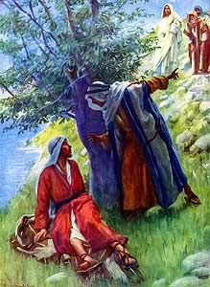
The Gospel is spread by Christians sharing it with people they know
Isaiah 2:2-3 - “Come, and let us go up to the mountain of the Lord”
John 1:35-42 - “He first found his own brother Simon, and said to him, ‘We have found the Messiah.’ And he brought him to Jesus”
John 1:43-46 - “Philip found Nathanael and said to him, ‘We have found Him of whom Moses in the law, and also the prophets, wrote - Jesus... Come and see’”
John 4:28-30 - “Come, see a Man who told me all things that I ever did. Could this be the Christ?”
Acts 10:24 - “called together his relatives and close friends”
2 Timothy 2:2 - “Commit these to faithful men who will be able to teach others also.”

Slide 4
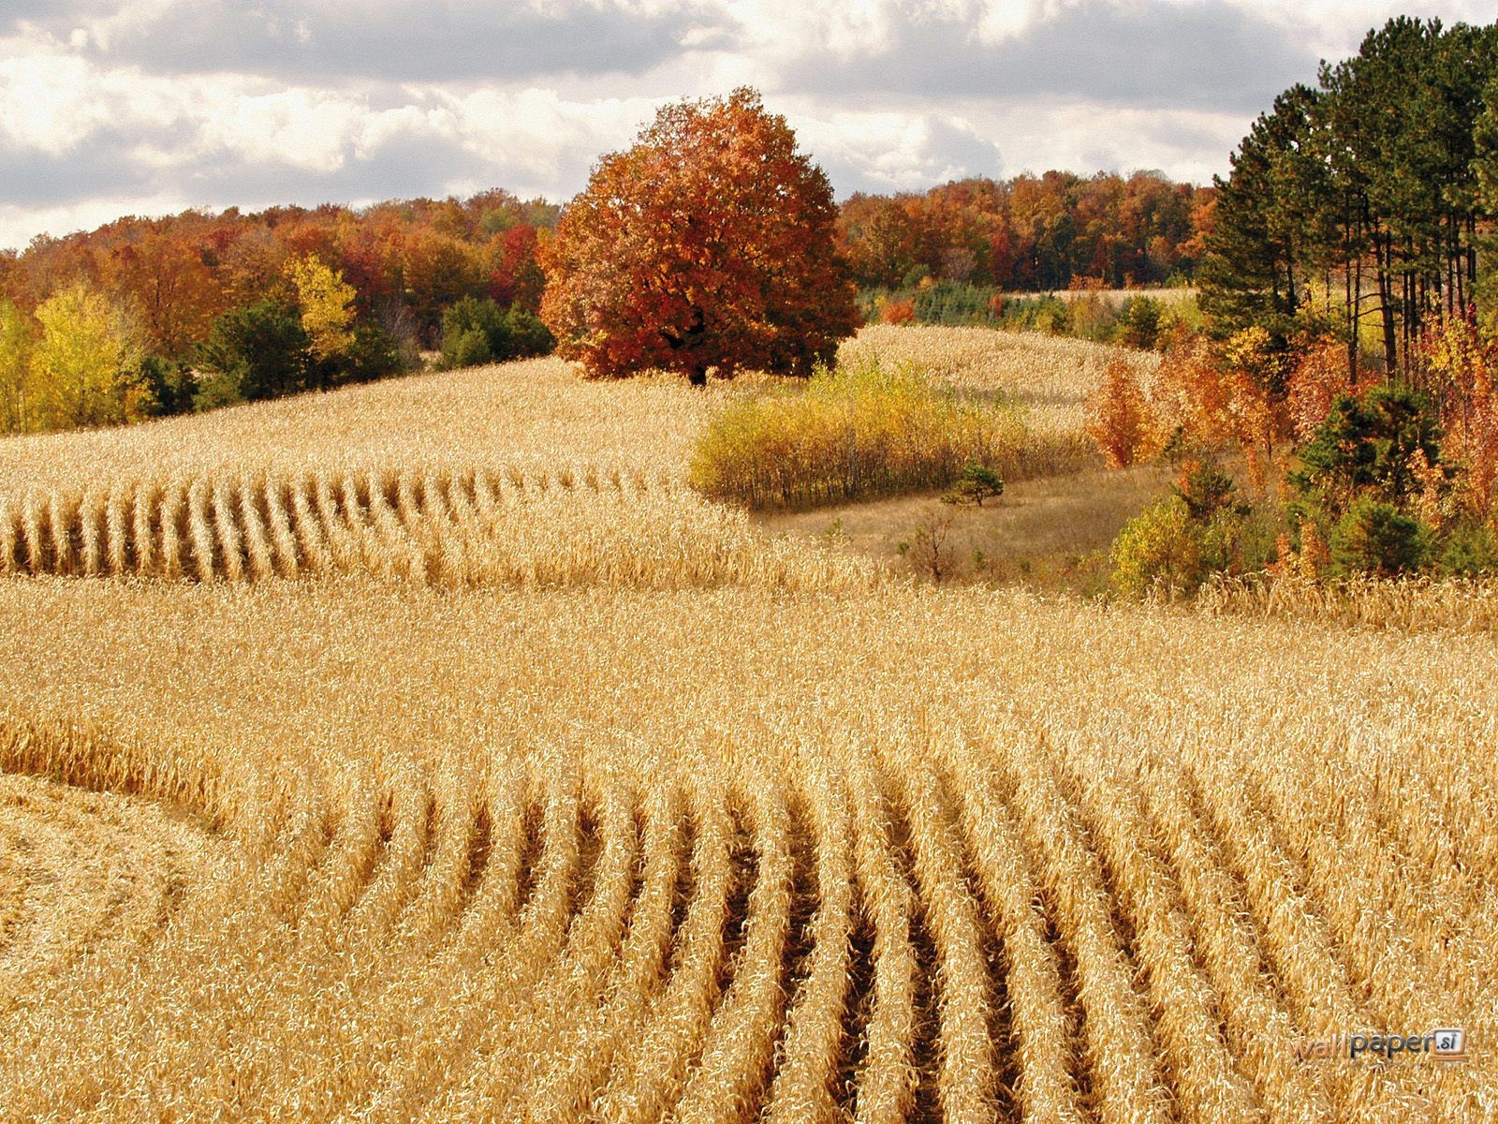
Matthew 9:36-38 - “The harvest truly is plentiful, but the laborers are few. Therefore pray the Lord of the harvest to send out laborers into His harvest.”
How many people do you know on a first name basis that are in need of the gospel?
How are they ever going to learn the truth?

Slide 5
Evangelism Goals for Next 12 Months
Set up a Bible study with 5 people you know that are in need of the gospel
More than passing spiritual discussion
A study that works toward meeting the spiritual needs that person may have

Slide 6
Evangelism Goals for Next 12 Months
Set up a Bible study with 5 people you know that are in need of the gospel
It would be best if you lead the study (1 Peter 3:15, Hebrews 5:12)
But others are willing to help

Slide 7
Things You Can Start Doing Today
Begin making a list of people you know that you could talk to about the gospel
Begin praying for opportunities with these people
Begin thinking about how you can approach these people about a study

Slide 8
“Behold, I say to you, lift up your eyes and look at the fields, for they are already white for harvest! And he who reaps receives wages, and gathers fruit for eternal life...”

